Slide 1
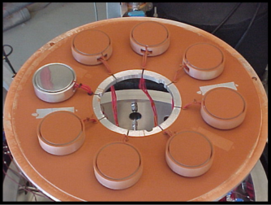
Lunar Dust level sensor & Effects of Surfaces (LDES) Overview
PI: NASA JSC/Kathryn Miller Hurlbert, Ph.D.
Experiment based on previous program to test the effects of Mars dust on radiator performance (published in 2004 & 2006)
  Ground based testing in a thermal vacuum bell jar
  showed significant impact as dust level increased
LDES is same/similar ground test, but with lunar dust simulant and with environ of the Moon’s South Pole
Proposed to mount the test articles on to lunar landers and/or rover(s), at various locations to:
    Attain data in South Pole environ, including after landing, traverse, etc.
    “Reverse” the experiment and use as a dust detector, to estimate the dust accumulation at various locations
Mars Dust Testing
Designed the test articles for a known heat flux through the top test surface
Notes:
the coupons are designed to be nearly adiabatic at all surfaces other than the radiator test surface and an energy balance is applied to yield the radiative component of the heat transfer, and thus the effective emittance of the test surface.

Slide 2
Test Objectives
Multiple test series completed this year with lunar simulants
The primary objectives for testing were:
to characterize radiator performance and assess changes in optical properties under lunar dust and Moon conditions with a variety of radiator coatings/surface treatments and dust thicknesses, for comparison to the previous results using Mars dust (early 2000s)
to obtain data for various surface treatments/coatings to support selection for a dust sensor to be developed and flown on an early flight opportunity
A secondary objective was:
to evaluate the operations and performance of a new dusty thermal vacuum chamber

Slide 3
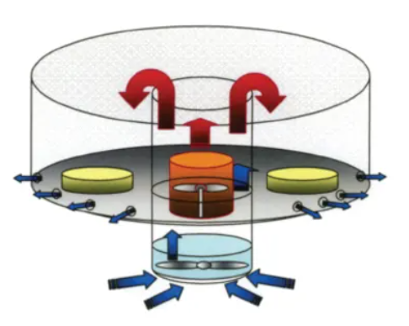
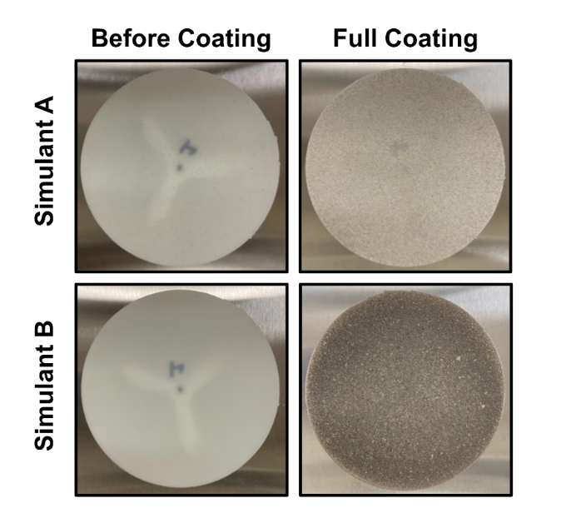
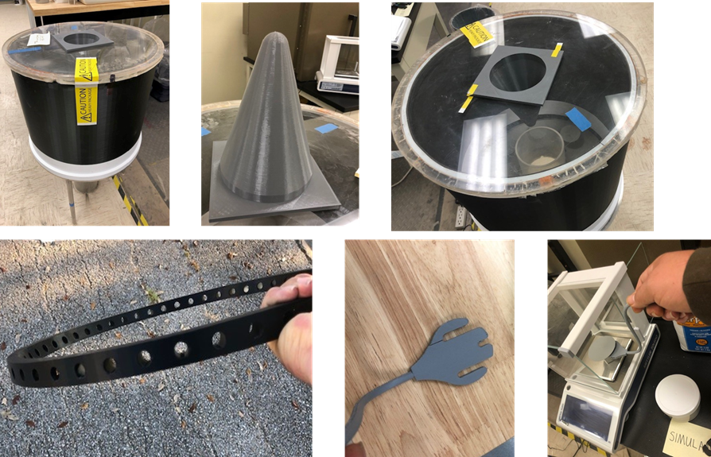
Dust Distributor
Schematic depiction of the dusting apparatus is shown from a published NASA Tech Brief
Other images from TFAWS paper

Slide 4
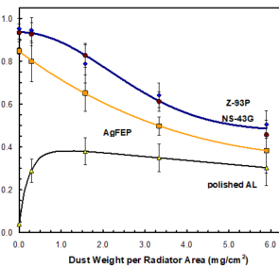
Mars Dust Study
Mars Simulant
Carbondale Red Clay
Effective Emittance

Slide 5
References
Hollingsworth, D. Keith, et al. “Reduction in Emittance of Thermal Radiator Coatings Caused by the Accumulation of a Martian Dust Simulant.” Applied Thermal Engineering, vol. 26, no. 17-18, 2006, pp. 2383–2392.
NASA. “Uniform Dust Distributor for Testing Radiative Emittance of Dust-Coated Surfaces.” NASA Tech Briefs, 3 Aug. 2017, https://www.techbriefs.com/component/content/article/tb/pub/briefs/mechanics-and-machinery/12644.
NOTE: see paper presented at this year’s TFAWS conference titled “DESIGN AND TESTING OF A DEVICE FOR MOON DUST DEPOSITION ON TEST ARTICLES/SYSTEMS”

